Slide 1
SVM Modeling Techniques
CUNY LaGuardia Community College

Slide 2

What is SVM?
Definition: Support Vector Machine (SVM) is a powerful classifier in machine learning that finds the best boundary between different groups, or classes, of data.

Slide 3
What is SVM?
Imagine you’re running a movie theater, and you need to set an age cutoff line between adult and child tickets. You want this line to be as clear as possible, with a “buffer” zone on either side, so it’s obvious who qualifies as a child and who qualifies as an adult.
SVM works similarly. It finds the “cutoff line” (or hyperplane) that best separates two groups of data, creating the widest possible margin between them. The data points closest to this margin are called support vectors, and they help determine exactly where that boundary should be.

Slide 4
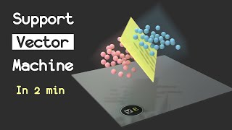

Slide 5
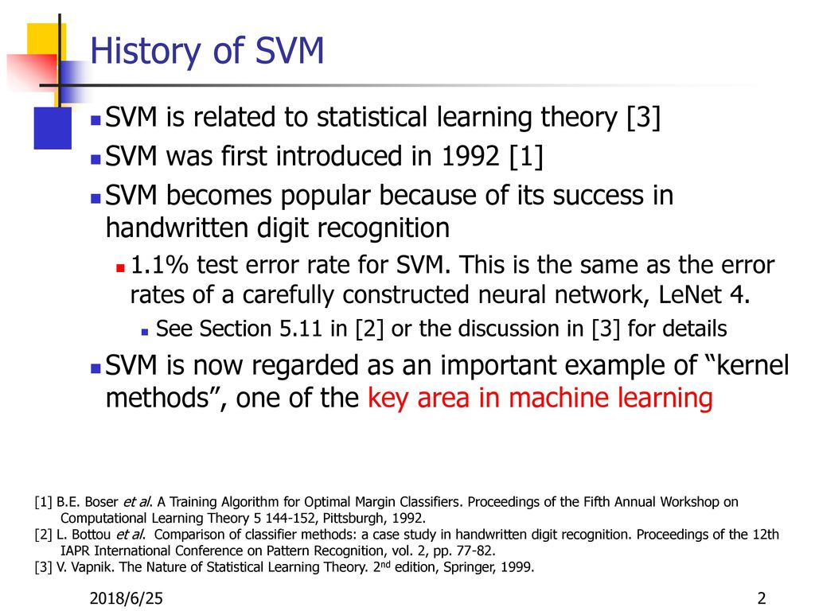
History of SVM

Slide 6
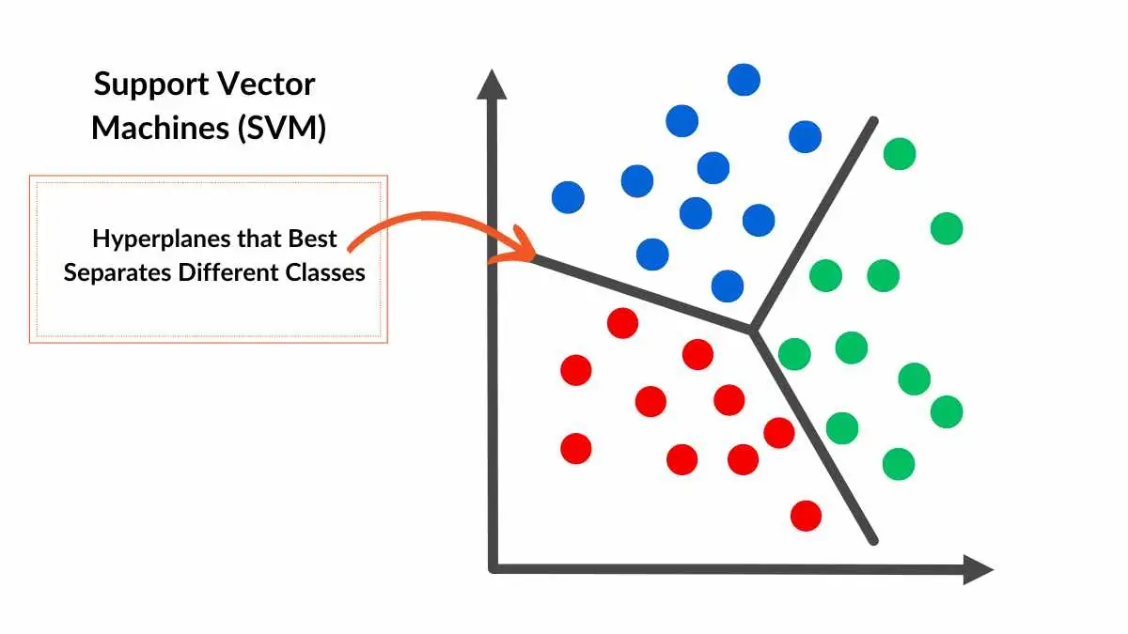
SVM Hyperplanes

Slide 7
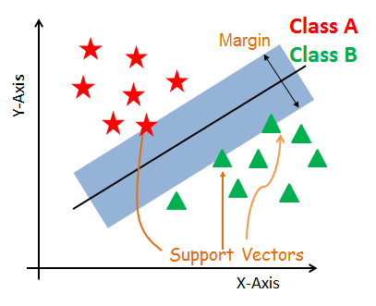
SVM Support Vectors

Slide 8
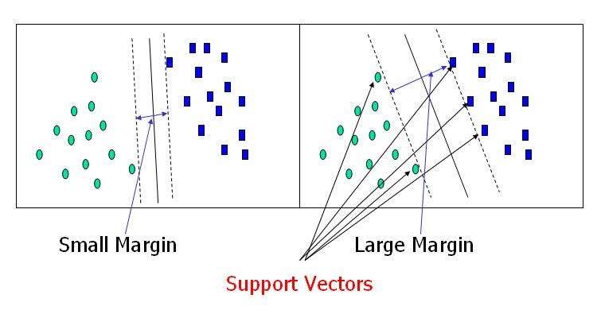
SVM Margins

Slide 9
SVM Modeling
SVM Modeling is the process of applying the Support Vector Machine (SVM) algorithm to a specific classification problem. It goes beyond just understanding SVM as a tool; it involves tailoring the SVM to fit the unique characteristics of a dataset and problem. Two attributes of SVM that are determined for during SVM modeling are:
kernel type
C parameter

Slide 10
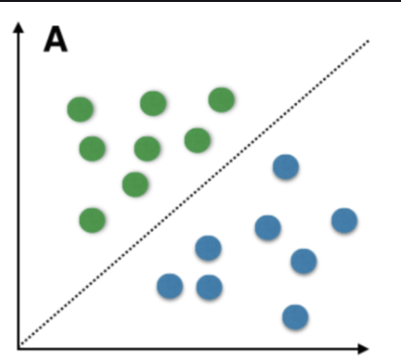
Kernel Types: Linear Kernels
Imagine you have data like this:
Due to the natural linear divide between the data points, a linear hyperplane can be chosen to separate the data.

Slide 11

Kernel Types: Radial Basis Function (RBF) Kernels
However, sometimes you have data like this, such as in cases of object recognition or signal processing, where the internal separation is complex instead of linear. In cases like this, the kernel must also be raised to three dimensions, so that it can then be linearly seperable.

Slide 12
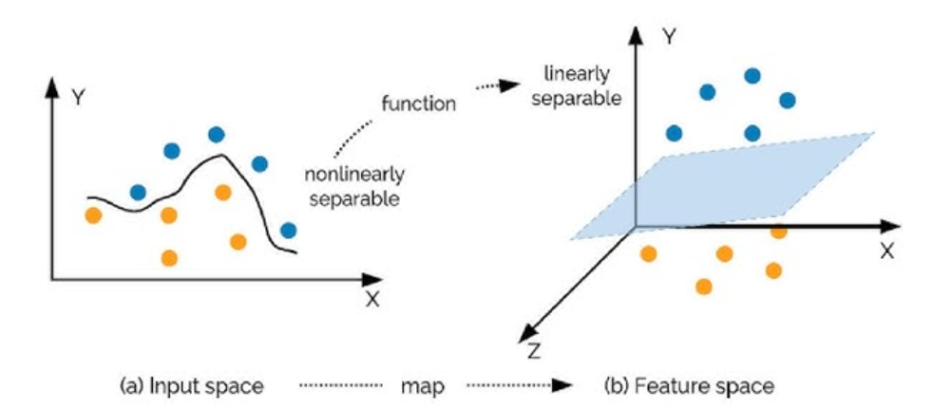
Kernel Types: Polynomial Kernel
In real world data cases, many complex patterns will arise when trying to create optimal hyperplanes. Polynomial kernels are used to map data into polynomial dimensions to make data into linearly separable data.

Slide 13
SVM Model Training
Input Data
Define the Hyperplane
Training and Prediction
Collect and preprocess the data, ensuring features are properly scaled and relevant for the classification task.
SVM identifies the optimal hyperplane by maximizing the margin between classes.
Support vectors (the closest data points) help determine the position and orientation of this hyperplane.
SVM learns from the training data, adjusting parameters to minimize errors while keeping the widest margin possible.
With the trained model, SVM can classify new, unseen data points based on which side of the hyperplane they fall on.

Slide 14
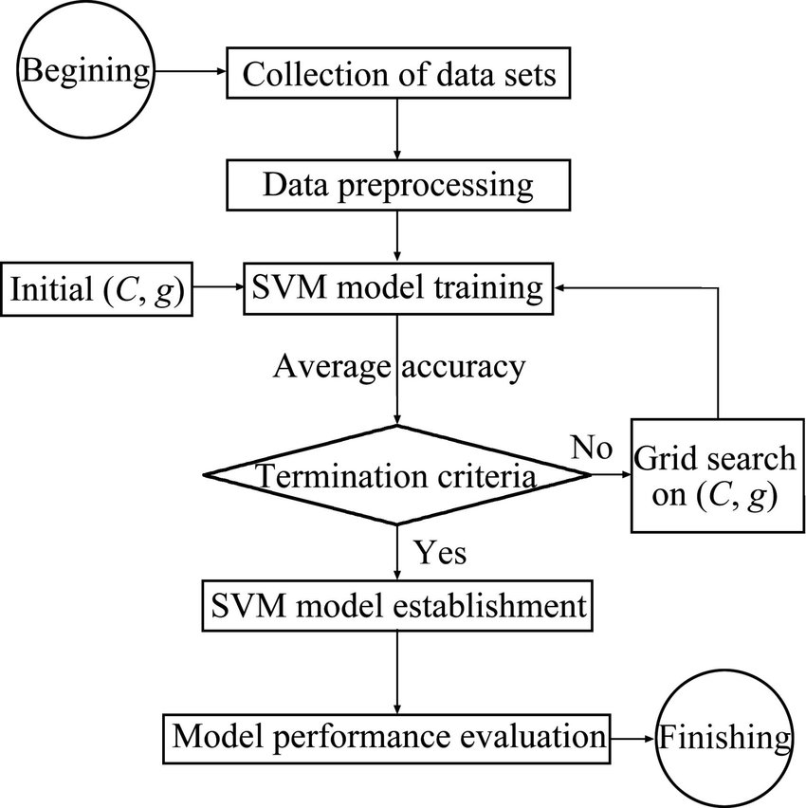
SVM Training Loop

Slide 15
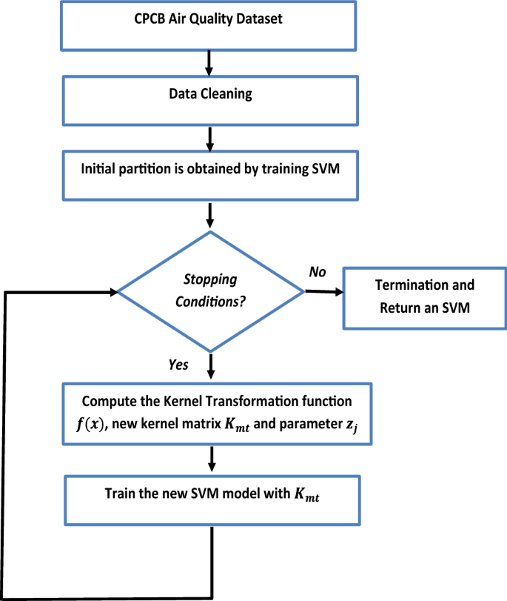
Case Study

Slide 16
Termination Conditions
In SVM training, termination conditions define when the model has learned enough and can stop optimizing. These conditions ensure the model reaches a reliable solution without overdoing it. Conditions include:
Convergence Tolerance
Stops training when improvements between steps become very small, indicating the model is close to optimal.
Maximum Iterations
Sets an upper limit on the number of training cycles to avoid endless loops, especially with complex data.
Stabilized Support Vectors
Training stops if the support vectors (key data points defining the boundary) no longer change, signaling a stable solution.

Slide 17
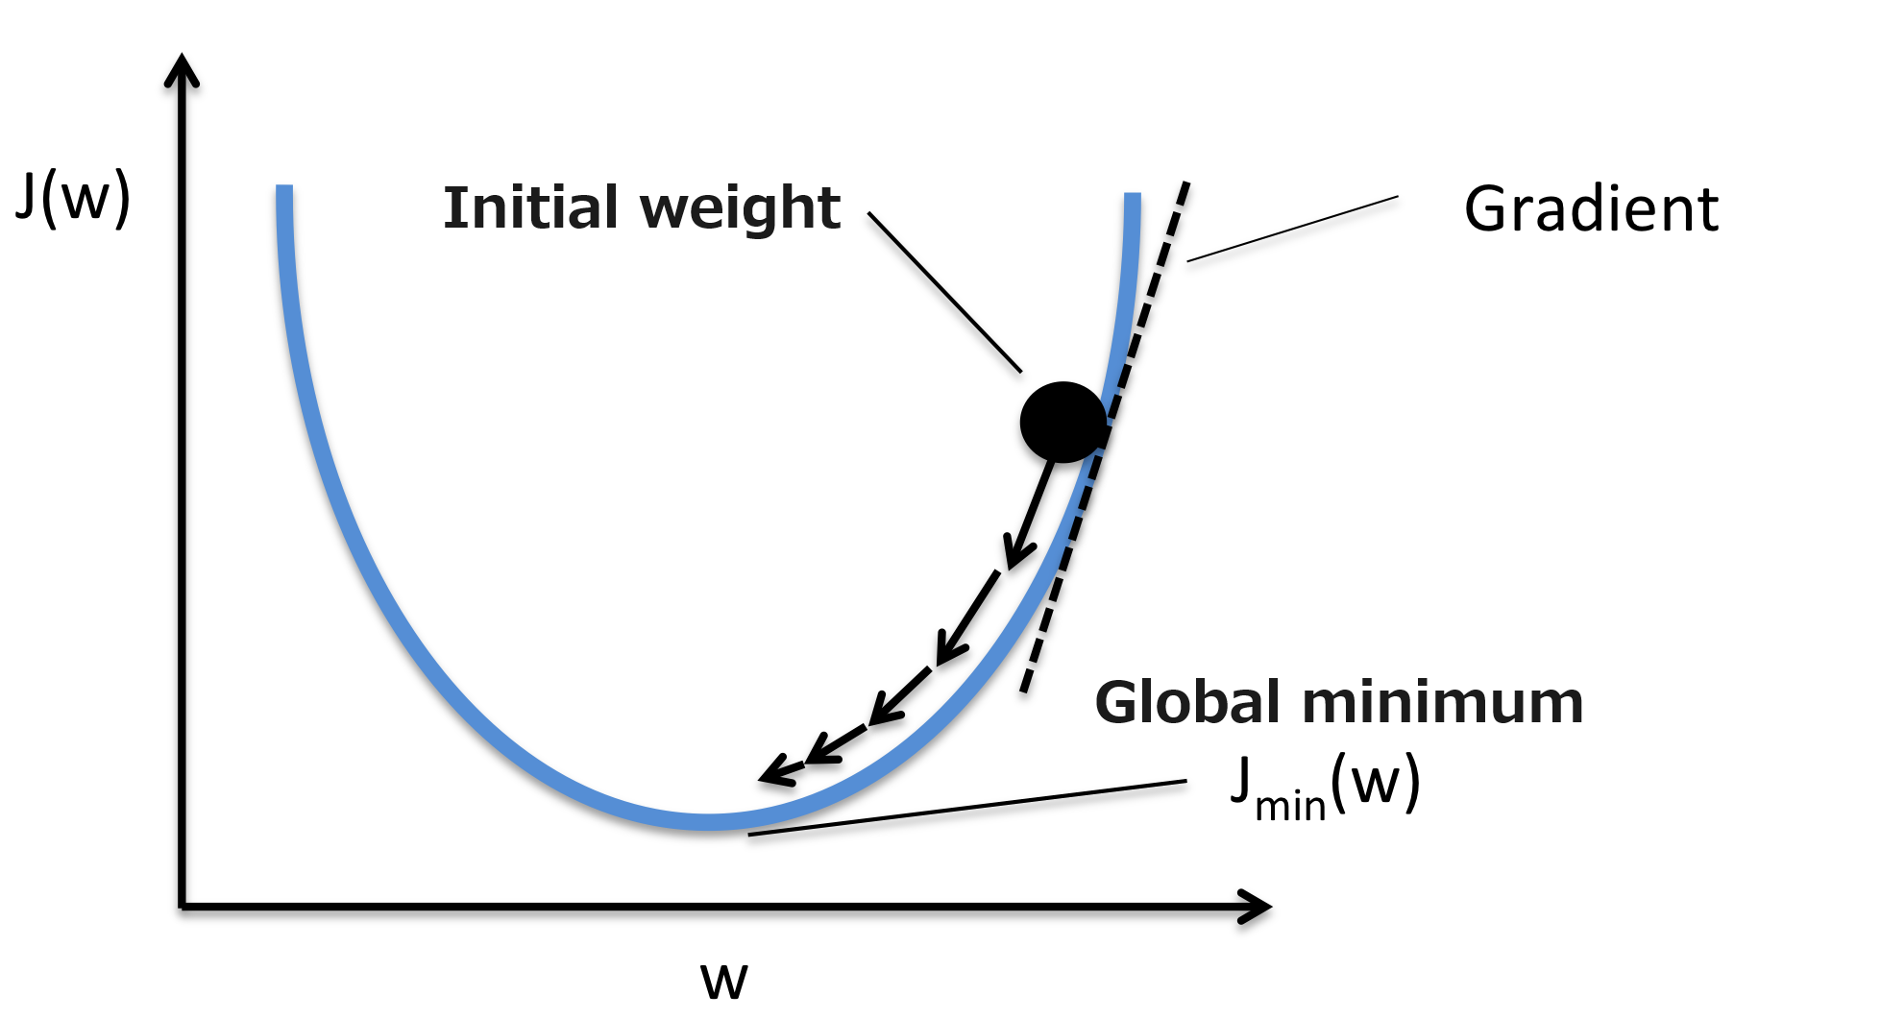
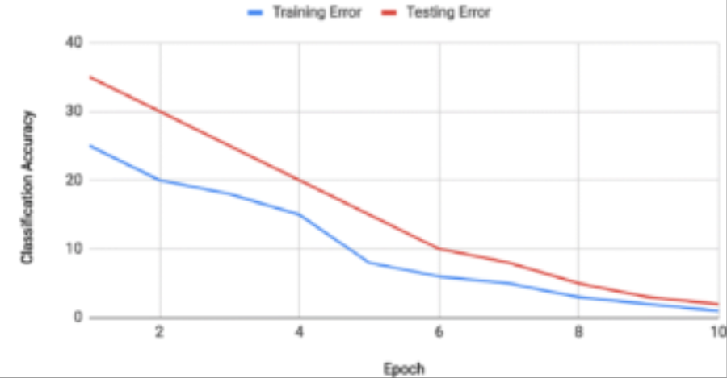
Convergence

Slide 18
SVM Modeling Techniques: Hyperparameter Tuning
Hyperparameter tuning helps adjust SVM’s settings to find the right balance between accuracy and generalization. Proper tuning can prevent overfitting (too specific) or underfitting (too simple). The goal is to optimize the model for the best performance on new data.
The main SVM model hyperparameters are
C Parameter
Gamma (for non-linear kernels)
Kernel Type

Slide 19
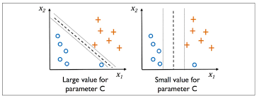
C Parameter
C is a regularization parameter that controls the trade-off between maximizing the margin and minimizing misclassification errors.

Slide 20

Overfitting and Underfitting

Slide 21
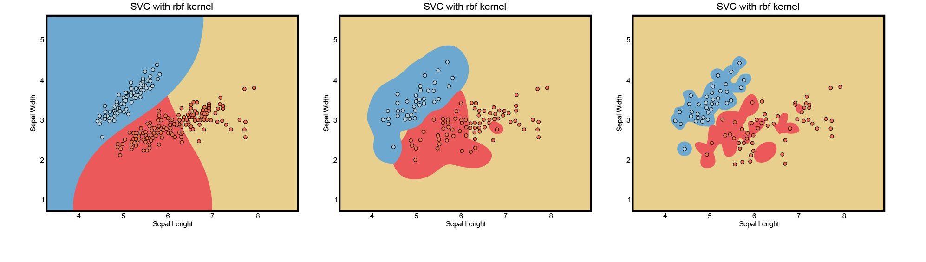
Gamma Parameter
Gamma is a parameter for non-linear SVMs (e.g., RBF and polynomial kernels) that controls the influence of individual training examples.
Low Gamma Regular Gamma High Gamma

Slide 22
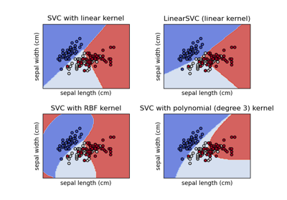
Kernel Parameter

Slide 23
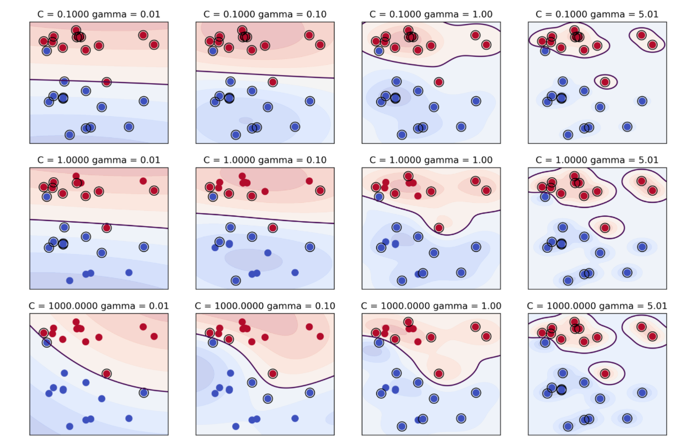
Impact of Hypertuning

Slide 24
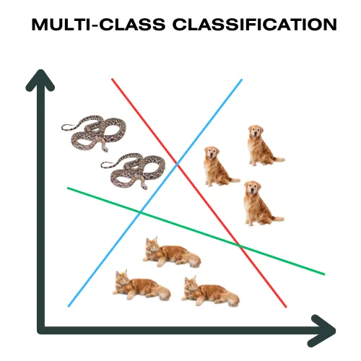
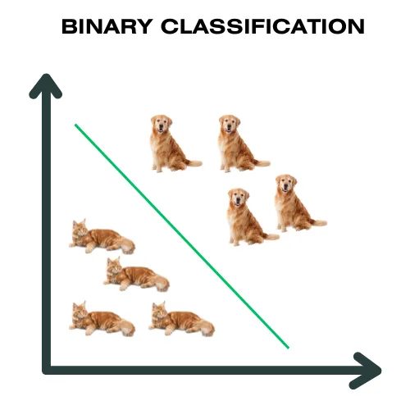
Binary vs Multiclass SVM
Binary SVM classifies data into two categories by finding the optimal boundary between them. Multiclass SVM extends this to multiple categories by combining several binary classifiers, using either one-vs-one or one-vs-rest approaches. This allows SVM to handle more complex classification tasks beyond two classes.

Slide 25
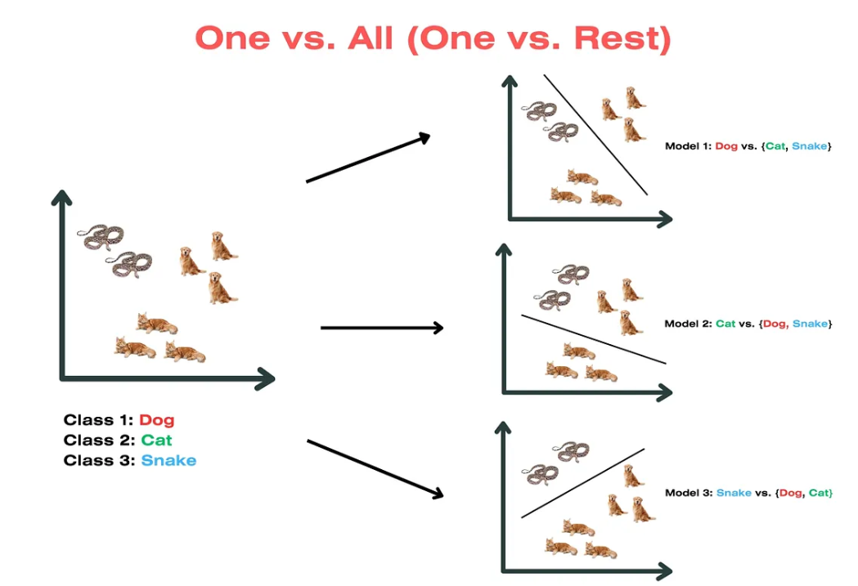
Multiclass SVM Techniques: One vs Rest (OVR)

Slide 26
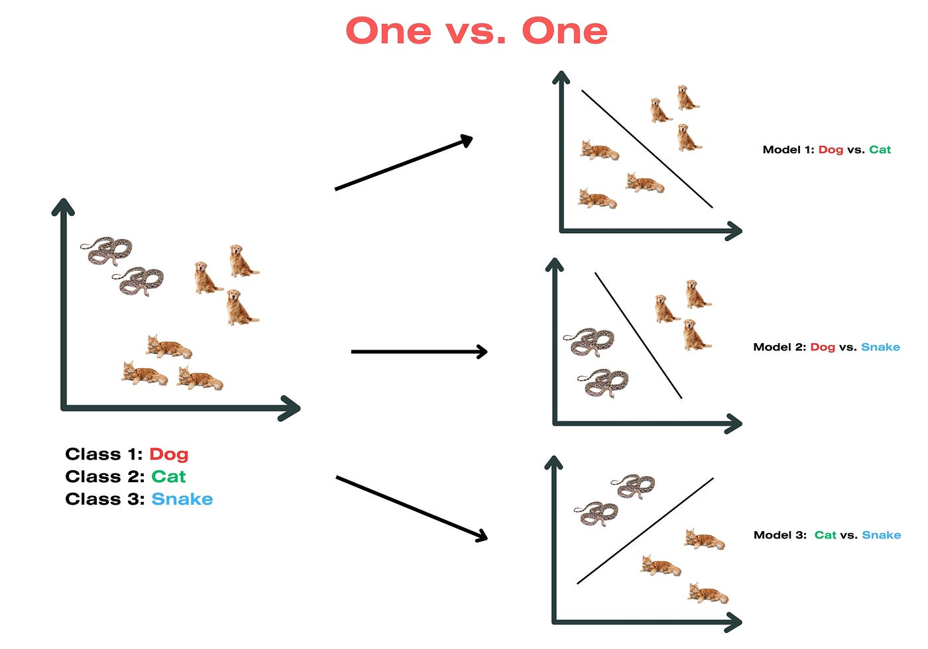
Multiclass SVM Techniques: One vs One (OVO)

Slide 27
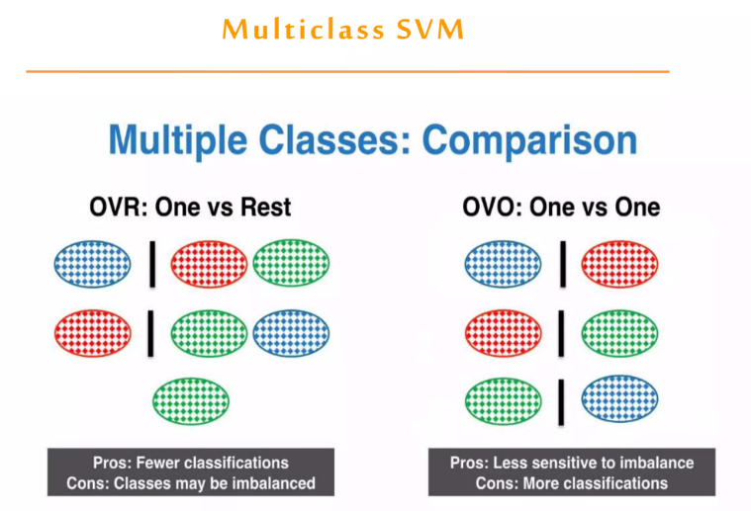
Multiclass SVM Techniques: Comparison

Slide 28
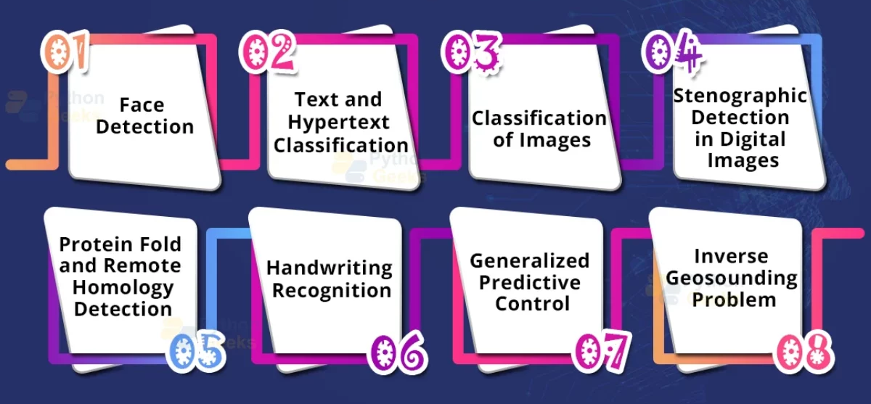
Applications of SVM

Slide 29
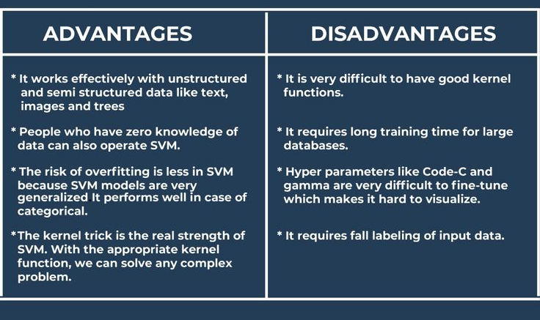
Advantages and Disadvantages

